Slide 1
Household Portfolio Choice and Cash Flows in the EA Countries
Katarzyna Kochaniak
Cracow University of Economics

Slide 2
RQ
Do the individual populations perceive the same type of financial assets as a component of major importance for their wealth?
Are the households’ investment preferences uniform across the Eurozone or formed within certain subsets of member states?
Is the structure of portfolios significantly shaped by households’ size and cash flows in individual countries?
At which values of annual gross income and monthly repayments of loans does the risk profile of a household’s portfolio change most significantly?
At what household size does the greatest modifications of portfolio structure occur?

Slide 3
Financial asset portfolio
deposits (sight and saving) - D,
deposits on managed accounts - MA,
mutual fund units - MF,
bonds - B,
shares publicly traded - S,
private lending - MO,
voluntary pension plans or whole life insurance contracts – VP_WLI,
non-self-employment private businesses - NSEB,
other (options, futures, index certificates, precious metals, oil and gas leases, future proceeds from a lawsuit or estate that is in the process of being settled, and royalties) - OA.

Slide 4
Data description
DATABASE: the Eurosystem HFCS;
COUNTRIES: Austria (AT), Belgium (BE), Cyprus (CY), Germany (DE), Spain (ES), Finland (FI), France (FR), Greece (GR), Italy (IT), Luxembourg (LU), Malta (MT), the Netherlands (NL), Portugal (PT), Slovenia (SI) and Slovakia (SK);
DATA: individual, household-level (No. of HHs: 59,158):
financial assets,
real assets,
financial debt,
net wealth (NW = total assets – total debt).

Slide 5
Average values of financial asset portfolios
3%
2%
10%
3%
4%
0%
1%
25%
17%
2%
3%
3%
6%
13%
7%
5%

Slide 6
Average structure of financial asset portfolios

Slide 7
Country | 1- 2 components | 3 and more components
AT | 89% | 11%
BE | 71% | 29%
CY | 70% | 30%
DE | 65% | 35%
ES | 78% | 22%
FI | 73% | 27%
FR | 73% | 27%
GR | 99% | 1%
IT | 86% | 14%
LU | 74% | 26%
MT | 80% | 20%
NL | 72% | 28%
PT | 95% | 5%
SI | 86% | 14%
SK | 95% | 5%
EA | 78% | 22%

Slide 8
 | D/TFA | MF/TFA | B/TFA | NSEB/TFA | S/TFA | MA/TFA | MO/TFA | OA/TFA | VP_WLI/TFA
AT - D/TFA | 1 | -0.45 | -0.37 | -0.15 | -0.27 | -0.05 | -0.47 | -0.15 | -0.52
BE - D/TFA | 1 | -0.36 | -0.25 | -0.10 | -0.26 | -0.09 | -0.19 | -0.13 | -0.64
CY - D/TFA | 1 | -0.08 | -0.14 | -0.10 | -0.25 | x | -0.20 | x | -0.76
DE - D/TFA | 1 | -0.33 | -0.23 | -0.08 | -0.29 | -0.05 | -0.24 | -0.19 | -0.64
ES - D/TFA | 1 | -0.37 | -0.17 | -0.24 | -0.50 | -0.12 | -0.29 | x | -0.54
FI - D/TFA | 1 | -0.51 | -0.11 | x | -0.55 | x | x | x | -0.60
FR - D/TFA | 1 | -0.28 | -0.13 | -0.18 | -0.39 | -0.04 | -0.16 | -0.16 | -0.78
GR - D/TFA | 1 | -0.26 | -0.19 | -0.18 | -0.38 | x | -0.60 | x | -0.57
IT - D/TFA | 1 | -0.35 | -0.60 | -0.11 | -0.25 | -0.16 | -0.09 | -0.16 | -0.52
LU - D/TFA | 1 | -0.43 | -0.20 | -0.09 | -0.27 | -0.07 | -0.21 | -0.13 | -0.67
LU - VP_WLI/TFA | -0.67 | -0.10 | -0.07 | x | -0.08 | x | -0.07 | x | 1
MT - D/TFA | 1 | -0.24 | -0.57 | -0.08 | -0.36 | -0.10 | -0.16 | -0.07 | -0.55
NL - D/TFA | 1 | -0.19 | -0.16 | x | -0.14 | x | -0.14 | -0.09 | -0.84
PT - D/TFA | 1 | -0.26 | -0.09 | -0.11 | -0.30 | -0.05 | -0.57 | -0.04 | -0.66
SI - D/TFA | 1 | -0.38 | -0.11 | x | -0.30 | x | -0.35 | x | -0.65
SK - D/TFA | 1 | -0.35 | -0.07 | -0.09 | -0.08 | -0.14 | -0.45 | x | -0.74
EA - D/TFA | 1 | -0.36 | -0.25 | -0.15 | -0.39 | -0.08 | -0.22 | -0.13 | -0.68

Slide 9
Decomposition of financial asset portfolios
safe (S): sight deposits, saving deposits;
relatively safe (RS): voluntary pension plans and whole life insurance contracts, bonds;
risky (R): non-self-employment private businesses, mutual fund units, shares, managed accounts, other assets, private lending.

Slide 10
Category of assets | Mean | Median | HH with no assets from this category | HHs with only assets from this category | HHs with assets from this category | Coefficient of variation
AT (n=2,315)
S | 85.76% | 100.00% | 0.52% | 66.52% | 99.48% | 31.01%
RS | 6.56% | 0.00% | 80.13% | 0.09% | 19.87% | 274.81%
R | 7.68% | 0.00% | 78.27% | 0.43% | 21.73% | 263.49%
BE (n=2,275)
S | 60.43% | 66.67% | 0.40% | 34.77% | 99.60% | 62.40%
RS | 24.64% | 2.47% | 49.01% | 0.13% | 50.99% | 133.00%
R | 14.92% | 0.00% | 60.88% | 0.22% | 39.12% | 180.45%
CY (n=1,108)
S | 47.32% | 43.86% | 18.41% | 21.75% | 81.59% | 87.27%
RS | 38.90% | 24.89% | 38.18% | 9.12% | 61.82% | 103.47%
R | 13.78% | 0.00% | 50.18% | 3.25% | 49.82% | 192.19%
DE (n=3,474)
S | 58.63% | 60.66% | 1.64% | 27.81% | 98.36% | 61.36%
RS | 25.69% | 0.38% | 44.30% | 0.78% | 55.70% | 121.18%
R | 15.68% | 0.00% | 54.26% | 0.52% | 45.74% | 166.29%

Slide 11
Category of assets | Mean | Median | HH with no assets from this category | HHs with only assets from this category | HHs with assets from this category | Coefficient of variation
ES (n=5,956)
S | 69.70% | 100.00% | 0.91% | 50.84% | 99.09% | 54.21%
RS | 12.38% | 0.00% | 69.11% | 0.37% | 30.89% | 201.23%
R | 17.92% | 0.00% | 65.21% | 0.39% | 34.79% | 173.12%
FI (n=10,989)
S | 73.44% | 93.92% | 0.00% | 41.94% | 100.00% | 45.66%
RS | 11.00% | 0.00% | 67.46% | 0.00% | 32.54% | 203.82%
R | 15.56% | 0.00% | 54.06% | 0.00% | 45.94% | 171.32%
FR (n=14,868)
S | 67.59% | 85.85% | 0.19% | 43.38% | 99.81% | 53.95%
RS | 21.26% | 0.00% | 54.37% | 0.09% | 45.63% | 142.75%
R | 11.14% | 0.00% | 64.49% | 0.07% | 35.51% | 199.57%
GR (n=2,219)
S | 92.82% | 100.00% | 1.58% | 86.71% | 98.42% | 23.94%
RS | 2.63% | 0.00% | 95.09% | 0.59% | 4.91% | 525.05%
R | 4.55% | 0.00% | 90.31% | 0.95% | 9.69% | 390.46%

Slide 12
Category of assets | Mean | Median | HH with no assets from this category | HHs with only assets from this category | HHs with assets from this category | Coefficient of variation
IT (n=6,590)
S | 73.27% | 100.00% | 2.58% | 57.81% | 97.42% | 49.36%
RS | 19.48% | 0.00% | 64.66% | 2.08% | 35.34% | 160.82%
R | 7.25% | 0.00% | 82.43 | 0.23% | 17.57% | 269.58%
LU (n=936)
S | 66.73% | 84.38% | 0.21% | 41.67% | 99.79% | 55.17%
RS | 19.28% | 0.00% | 58.01% | 0.21% | 41.99% | 156.36%
R | 13.99% | 0.00% | 62.29% | 0.00% | 37.71% | 186.22%
MT (n=814)
S | 71.79% | 98.86% | 0.12% | 49.63% | 99.88% | 48.18%
RS | 20.29% | 0.00% | 59.46% | 0.00% | 40.54% | 149.47%
R | 7.91% | 0.00% | 75.18% | 0.12% | 24.82% | 240.33%
NL (n=1,261)
S | 53.51% | 50.81% | 4.68% | 28.95% | 95.32% | 73.20%
RS | 37.30% | 24.91% | 39.81% | 4.12% | 60.19% | 102.95%
R | 9.19% | 0.00% | 64.55% | 0.40% | 35.45% | 212.35%

Slide 13
Category of assets | Mean | Median | HH with no assets from this category | HHs with only assets from this category | HHs with assets from this category | Coefficient of variation
PT (n=4,143)
S | 87.26% | 100.00% | 0.29% | 73.57% | 99.71% | 30.90%
RS | 6.16% | 0.00% | 84.31% | 0.02% | 15.69% | 305.94%
R | 6.58% | 0.00% | 84.38% | 0.27% | 15.62% | 305.24%
SI (n=300)
S | 70.77% | 97.95% | 4.67% | 48.67% | 95.33% | 53.79%
RS | 13.79% | 0.00% | 72.67% | 1.67% | 27.33% | 212.38%
R | 15.44% | 0.00% | 64.33% | 2.33% | 35.67% | 186.75%
SK (n=1910)
S | 84.27% | 100.00% | 1.10% | 69.90% | 98.90% | 35.10%
RS | 9.42% | 0.00% | 81.05% | 0.58% | 18.95% | 248.50%
R | 6.31% | 0.00% | 84.92% | 0.41% | 15.08% | 313.99%
EA (n=59,158)
S | 71.67% | 98.92% | 1.15% | 49.10% | 98.85% | 49.99%
RS | 16.53% | 0.00% | 63.73% | 0.66% | 36.27% | 172.30%
R | 11.80% | 0.00% | 67.29% | 0.29% | 32.71% | 205.85%

Slide 14
Similarities / dissimilarities in financial asset portfolios’ structure

Slide 15
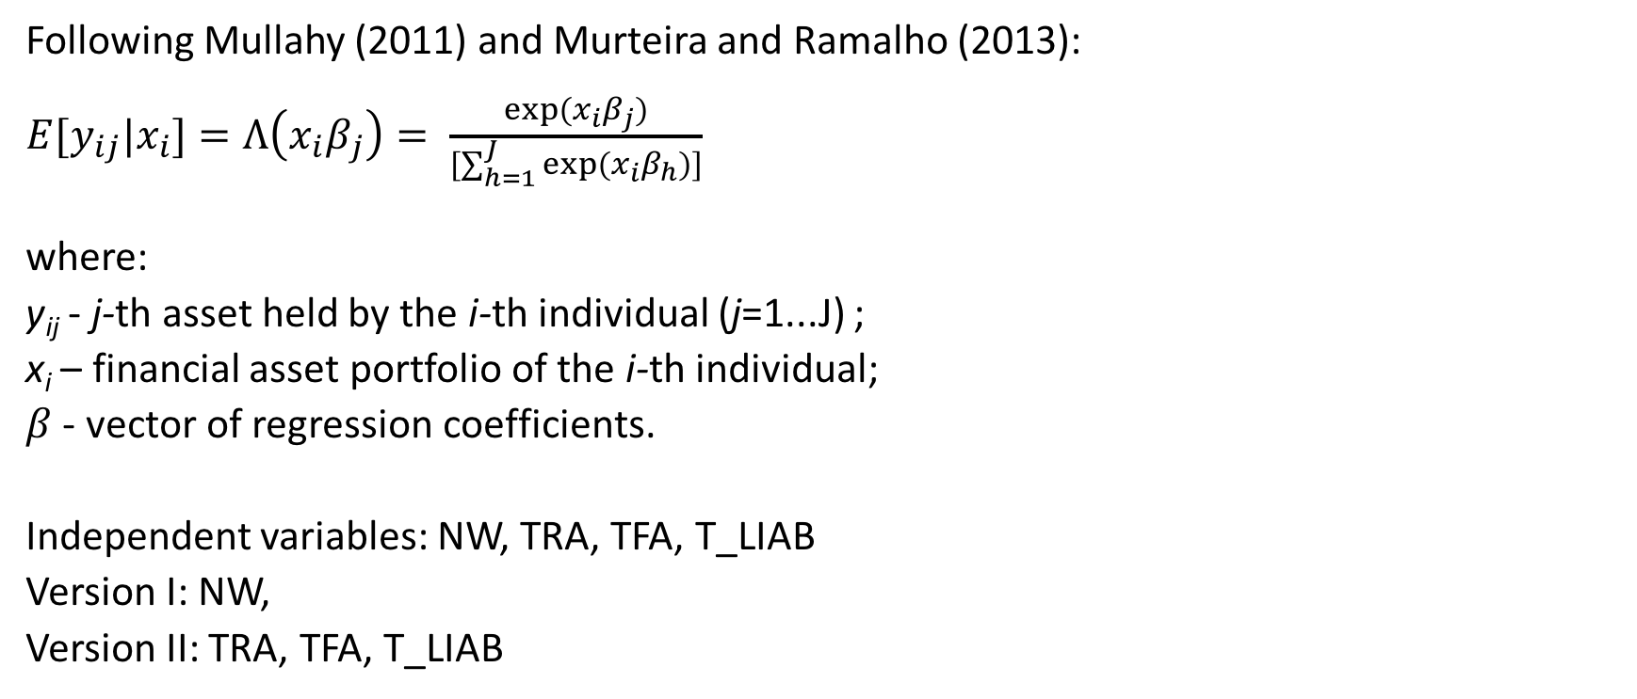
Fractional multinomial logit model (fmlogit)
Following Mullahy (2011) and Murteira and Ramalho (2013):
$E[y_{ij}|x_{i}]=Λ\left(x_{i}β_{j}\right)= \frac{exp⁡(x_{i}β_{j})}{[\sum_{h=1}^{J}{exp⁡(x_{i}β_{h})]}}$
where:
y_{ij} - j-th asset held by the i-th individual (j=1...J) ;
x_{i} – financial asset portfolio of the i-th individual; β
$β$ - vector of regression coefficients.
Independent variables: NW, TRA, TFA, T_LIAB
Version I: NW,
Version II: TRA, TFA, T_LIAB

Slide 16
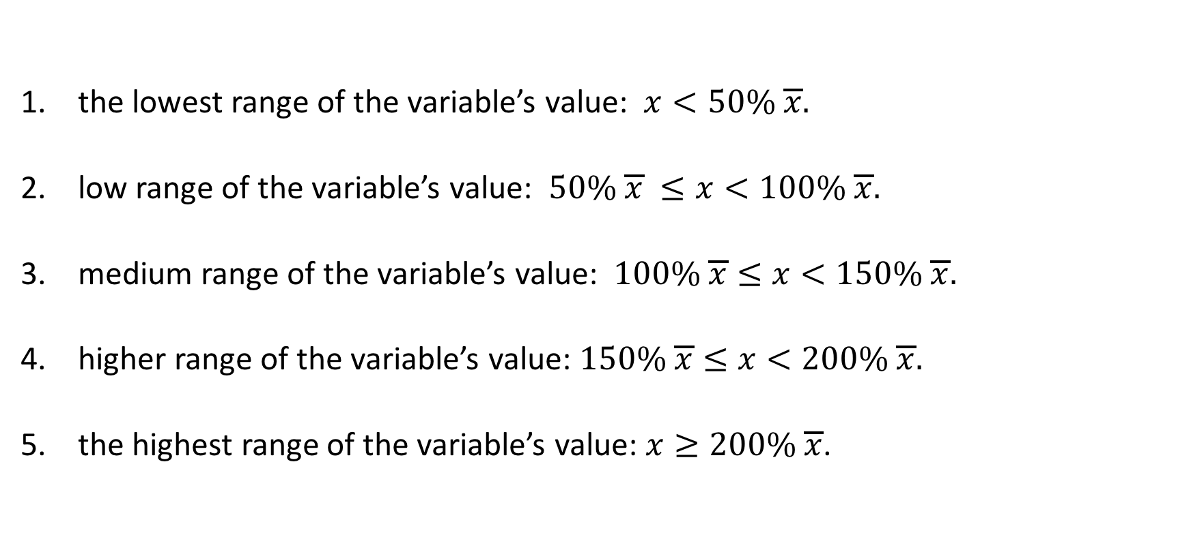
Transformation of TFA, TRA, T_LIAB and NW into dummies denoting the affiliation of a HH to one of the following classes
the lowest range of the variable’s value: $x<50\% \overline{x}.$
low range of the variable’s value: $50\% \overline{x} ≤x<100\% \overline{x}.$
medium range of the variable’s value: $100\% \overline{x}≤x<150\% \overline{x}.$
higher range of the variable’s value: $150\% \overline{x}≤x<200\% \overline{x}.$
the highest range of the variable’s value: $x≥200\% \overline{x}$.

Slide 17
HHs with the values of features from the lowest range (class 1) (% of population)
 | AT | BE | CY | DE | ES | FI | FR | GR | IT | LU | MT | NL | PT | SI | SK | EA
HHM | 36% | 30% | 10% | 23% | 20% | 23% | 28% | 21% | 24% | 24% | 17% | 25% | 21% | 12% | 21% | 24%
GI | 29% | 35% | 30% | 32% | 45% | 26% | 38% | 29% | 25% | 29% | 28% | 17% | 35% | 26% | 20% | 32%
TPAY | 83% | 37% | 46% | 68% | 68% | x* | 66% | 75% | 83% | 51% | 78% | 51% | 68% | 70% | 76% | 65%

Slide 18
The predicted structure of financial asset portfolio of a household characterised by HHM, GI, and T_PAY from the class 1

Slide 19
 | S/TFA | RS/TFA | R/TFA
HHM | AT (2-5) h* BE (2-5)l* CY (2-3)h*, CY (4)l, CY(5)h DE (2-5)h* ES (2)l, ES (3-5)h* FI (2-5)h** FR (2-5)h** GR (2-5)l* IT (2-5)h* LU (2)h, LU (3-4)l***, LU (5)h MT (2-4)l**, MT h(5) NL (2-5)l** PT (2-5)h* SI (2-5)l* SK (2-4)l**, SK(5)l EA (2-5)h* | AT (2-5)l* BE (2-5)h* CY (3-5)h*, CY (2)l DE (2-4)h**, DE (5)h ES (2-4)h**, ES (5)h FI (2-4)h**, FI (5)h FR (2-5)l** GR (2)h, GR (3)l, GR (5)l, GR (4)h IT (2-5)l* LU (2)l, LU (3-5)h*** MT (2-4)h**, MT(5)h NL (2-5)h** PT (2)l, PT (3-4)h**, PT (5)l SI (2-5)h** SK (2-5)h* EA (2)h, EA (3-4)l***, EA (5)h | AT (2-5)l* BE (2)h, BE (3-5)l* CY (2-5)l* DE (2-4)l**, DE (5)l ES (2)h, ES (3-5)l FI (2-5)l** FR (2-5)l** GR (2-5)h* IT(2-5)l** LU (2-5)l* MT (2-3)l**, MT (4)h, MT (5)l NL (2-5)l** PT (5)h* SI (2)h, SI (3)l, SI (4-5)h*** SK (2-4)h**, SK (5)h EA (2-4)l**, EA (5)l

Slide 20
 | S/TFA | RS/TFA | R/TFA
GI | AT (2-5)l** BE (2-5)l** CY (2-5)l* DE (2-5)l** ES (2-5)l** FI (2-5)l** FR (2-5)l** GR (2-5)l** IT (2-5)l** LU (2-4)l**, LU (5)l MT (2-5)l** NL (2-5)l* PT (2-5)l** SI (2-3)h**, SI (4)l, SI (5)h SK (2-4)l**, SK (5)l EA (2-5)l** | AT (2-5)h* BE (2-4)h*, BE (5)h CY (2-3)h*, CY (4)l, CY (5)h DE (2)h, D (3-5)h*** ES (2-4)h**, ES (5)h FI (2-5)h** FR (2-5)h** GR (2-4)h**, GR (5)h IT (2-5)h** LU (2-4)h*, LU (5)l MT (2-5)h** NL (2)h, NL (3)l, NL (4)h, NL (5)l PT (2-5)h** SI (2-3)l***, SI (4-5)h*** SK (2-4)h**, SK (5)h EA (2-5)h** | AT (2-5)h* BE (2-5)h* CY (2-5)h* DE (2-5)h** ES (2-5)h** FI (2-5)h** FR (2-5)h** GR (2-5)h* IT (2-5)h** LU (2-5)h** MT (2-5)h** NL (2-5)h** PT (2-5)h* SI (2-5)l* SK (2)h, SK (3)l, SK (4-5)h*** EA (2-5)h**

Slide 21
 | S/TFA | RS/TFA | R/TFA
T_PAY | AT (2)h, AT (3-5)l*** BE (2-5)l*** CY (2-5)l** DE (2-4)l***, DE (5)l ES (2)h, ES (3)l, ES (4)h, ES (5)l FR (2)h, FR (3)l, FR (4-5)h** GR (2-5)l* IT (2-4)l***, IT (5)l LU (2-4)l**, LU (5)l MT (2)l, MT (3-4)h**, MT (5)l NL (2-5)l* PT (2-4)l***, PT (5)l SI (2-4)l**, SI (5)l SK (2-3)l**, SK (4)h, SK (5)l EA (2-5)l* | AT (2-4)h**, AT (5)h BE (2-5)h* CY (2-5)h* DE (2-5)h* ES (2-5)h* FR (2-5)l* GR (2-3)h**, GR (4)l, GR (5)h IT (2-5)h* LU (2-4)h**, LU (5)h MT (2-4)l*, MT (5)h NL (2-5)h* PT (2-5)h* SI (2-5)h* SK (2-5)h* EA (2-4)h**, EA (5)h | AT (2)l, AT (3-5)h*** BE (2-3)h***, BE (4-5)l** CY (2)l, CY (3-5)h** DE (2-5)l* ES (2-4)l*, ES (5)h FR (2-5)h* GR (2-3)l**, GR (4-5)h*** IT (2-3)h**, IT (4)l, IT (5)h LU (2)l, LU (3)h, LU (4-5)l** MT (2-3)h***, MT (4)l, MT (5)h NL (2)l, NL (3-5)h** PT (2-3)h***, PT (4)l, PT (5)h SI (2-3)l***, SI (4-5)h*** SK (2-3)h***, SK (4)l, SK (5)h EA (2-5)h*

Slide 22
 | S/TFA |  | RS/TFA | R/TFA
AT | HHM GI T_PAY | +5 (0.05) | -5 (-0.02) | -5 (-0.04)
 |  | -5 (-0.24) | +5 (0.11) | +5 (0.12)
 |  | -3 (0.04) | +4 (0.02) | +3 (0.04); -2 (-0.02)
BE | HHM | -3 (0.04) | +5 (0.07) | -5 (-0.03)
 | GI | -5 (-0.23) | +4 (0.08) | +5 (0.17)
 | T_PAY | -2 (-0.11) | +2 (0.09) | -5 (-0.02)
CY | HHM | +2 (0.06); -4 (0.004) | +5 (0.05); -2 (-0.02) | -5 (-0.06)
 | GI | -5 (-0.14) | +2 (0.07); -4 (-0.002) | +5 (0.08)
 | T_PAY | -5 (-0.32) | +5 (0.20) | +5 (0.12)
DE | HHM | +2 (0.03) | +4 (0.07) | -4 (0.08)
 | GI | -5 (-0.29) | +3 (0.09) | +5 (0.22)
 | T_PAY | -5 (-0.06) | +2 (0.10) | -2 (0.07)

Slide 23
 | S/TFA |  | RS/TFA | R/TFA
ES | HHM | -2 (-0.02) | +4 (0.03) | +2 (0.01); -4 (-0.04)
 | GI | -5 (-0.46) | +4 (0.06) | +5 (0.42)
 | T_PAY | +4 (0.01); -5 (0.05) | +3 (0.04) | -2 (-0.04)
FI | HHM | +5 (0.04) | +4 (0.02) | -5 (-0.06)
 | GI | -5 (-0.41) | +5 (0.11) | +5 (0.30)
 | T_PAY | x | x | x
FR | HHM | +5 (0.09) | -5 (-0.06) | -5 (-0.03)
 | GI | -5 (-0.60) | +5 (0.32) | +5 (0.27)
 | T_PAY | +5 (0.01) | -5 (-0.02) | +3 (0.02)
GR | HHM | -5 (-0.03) | +2 (0.004); -5 (0.01) | +5 (0.03)
 | GI | -5 (-0.06) | +4 (0.04) | +5 (0.03)
 | T_PAY | -5 (-0.02) | +3 (0.03); -4 (-0.01) | +4 (0.02); -3 (0.01)

Slide 24
 | S/TFA |  | RS/TFA | R/TFA
IT | HHM | +3 (0.04) | -3 (-0.02) | -5 (-0.02)
 | GI | -5 (-0.46) | +5 (0.20) | +5 (0.26)
 | T_PAY | -2 (-0.03) | +2 (0.03) | +3 (0.02); -4 (-0.01)
LU | HHM | +2 (0.03); -3 (-0.01) | +3 (0.04) | -5 (-0.04)
 | GI | -4 (-0.35) | +4 (0.09) | +5 (0.34)
 | T_PAY | -4 (-0.08) | +4 (0.09) | +3 (0.001); -5 (-0.04)
MT | HHM | +5 (0.01); -4 (-0.06) | +4 (0.05) | +4 (0.01); -5 (-0.02)
 | GI | -5 (-0.21) | +5 (-0.11) | +5 (0.10)
 | T_PAY | +4 (0.03); -5 (-0.06) | +5 (0.03) | +5 (0.03); -4 (-0.02)
NL | HHM | -5 (-0.28) | +5 (0.31) | -5 (-0.03)
 | GI | -4 (-0.10) | +2 (0.02); -3 (0.03) | +5 (0.10)
 | T_PAY | -4 (-0.08) | +4 (0.04) | +4 (0.03)

Slide 25
 | S/TFA |  | RS/TFA | R/TFA
PT | HHM | +3 (0.02) | -5 (0.01) | +5 (0.001); -3 (-0.02)
 | GI | -5 (-0.16) | +5 (0.07) | +5 (0.09)
 | T_PAY | -2 (-0.05) | +5 (0.03) | +2 (0.04); -4 (-0.01)
SI | HHM | -5 (-0.19) | +5 (0.12) | +4 (0.12); -3 (-0.01)
 | GI | +3 (0.08); -4 (0.003) | +4 (0.04); -2 (-0.02) | -3 (-0.08)
 | T_PAY | -4 (-0.26) | +3 (0.16) | +4 (0.25); -2 (-0.09)
SK | HHM | -4 (-0.04) | +4 (0.02) | +4 (0.03);
 | GI | -4 (-0.07) | +4 (0.05) | +4 (0.02); -3 (-0.004)
 | T_PAY | +4 (0.01); -3 (0.10) | +5 (0.05) | +2 (0.06); -4 (-0.02)
EA | HHM | +3 (0.04) | +2 (0.002); -3 (-0.01) | -4 (-0.03)
 | GI | -5 (-0.39) | +5 (0.16) | +5 (0.23)
 | T_PAY | -3 (-0.04) | +4 (0.02) | +3 (0.02)

Slide 26
Conclusions
Do the individual populations perceive the same type of financial assets as a component of major importance for their wealth?
A: Yes, deposits (except Cyprus).
Are the households’ investment preferences uniform across the Eurozone or formed within certain subsets of member states?
A: They are formed within certain subsets of countries.
Is the structure of portfolios significantly shaped by households’ size and cash flows in individual countries?
A: Yes. However, the greatest impact is assigned to annual gross incomes.
At which values of annual gross income and monthly repayments of loans does the risk profile of a household’s portfolio change most significantly?
A: At values assigned to classes 4-5.
At what household size does the greatest modifications of portfolio structure occur?
A: At values assigned to classes 4-5.

Slide 27
Thank you for your attention
katarzyna.kochaniak@uek.krakow.pl

